Slide 1
Job Recommender System
Presented By:
Merugu Sindhu
Sambangi sai sravani
Guided By: Uma Maheshwari

Slide 2
OUTLINE
Abstract
Existing System
Proposed System
Hardware Configuration of Proposed System
Software Configuration of Proposed System
Architecture
Modules
Testing
Advantages of Proposed System
Disadvantages of Existing System
Conclusion

Slide 3
Abstract
Recent researches show that the increasing demands of technologies for human resource management in general and recruiting processes in particular. Most companies put the focus on their own e-recruiting platforms as primary recruitment channels. Job ads are published automatically on the job portal as soon as they are entered into the system. On the other hand, the applicant creates a profile to apply it for one of the listed job positions. The user profile is stored in the system, letting the applicant reuse it for other job position. The last functionality gives the companies possibility to create the applicants pool. Thus, the companies achieved a uniform view for all applicants‟ data in one candidate pool. This pool is used by the recruitment department to find the applicant documents. Appropriate applicants‟ documents are directed to the human resource depart-ments for more processing. In addition, the system supports all required communication processes as well as tracks applicant status inside the application process.

Slide 4
Existing System
In the earlier days, searching job becomes critical, if any jobseeker want to search for a job, he must search job through his required skills, it the long process to find job and send request to the particular job.

Slide 5
Proposed System
As we have seen, the present-day job seeker is faced with an array of problems before they can find a suitable job for themselves.
All existing work is so promising but lacks in some of the other aspects. The need is to eliminate these issues posed by past research and minimize the weaknesses of the systems.
The proposed system is designed to go forth with developing a fully functional user interface supporting a job aggregator and recommendation system.
Every aspect of the operation is made from scratch and in a customized sort of manner.

Slide 6
Hardware Configuration of Proposed System
System : Pentium IV 2.4 GHz.
Hard Disk : 40 GB
Floppy Drive : 1.44 Mb
Monitor : 15 VGA Colour
Mouse : Logitech.
RAM : Min 2 GB

Slide 7
Software Configuration of Proposed System
Operating System : Windows 10
Coding Language : JAVA
Data Base : MS SQL

Slide 8
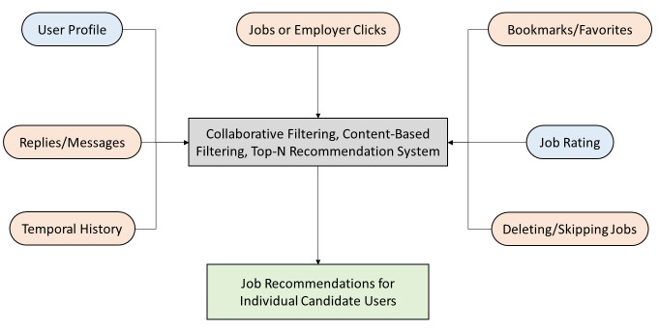
Architecture

Slide 9
Modules
The proposed system has the following modules:
Company
User

Slide 10
Module Description
Company:
Here company should register with the application after that he can login with the application and then perform some operation such as post job details and logout.
User:
Here user should register with the appilcation after that he can login with the application and then perform some operations such as search job details, view job details and logout.

Slide 11
Testing
TYPES OF TESTS :
UNIT TESTING
INTEGRATION TESTING
FUNCTIONAL TESTING
SYSTEM TESTING
WHITE BOX TESTING
BLACK BOX TESTING
ACCEPTANCE TESTING

Slide 12
Advantages of proposed system
1. Less time to get job
2. Automatically recommend job details
3. No need of more man power

Slide 13
Disadvantages of existing system
1. Time consume
2. We need to spend man power

Slide 14
CONCLUSION
Therefore, We conclude that job recommendation system with analysis of job description to recommend a job based on user’s skills and preferences presents itself as worthy Recsys model in recommending open position to the job seekers when looking for a new positions. Thus, among the different threshold and filtering techniques, we chose to model the recommender system using content-based filtering which is achieving F1-score of 66% with the Threshold of 0.3 with average coverage of 53%.

Slide 15
THANK YOU

